Slide 1


AirBnB Investment Opportunity
James Larkin – Faculty lead
Lujain - IA
Group Members:
Abduallah Almubark Abduallah Alkhadeer Omar Alsaghan

Slide 2
Should you invest in AirB&B real-estate in DC ?
if yes which Neighborhood ?

Slide 3

Indicators:
Which Neighborhood
How Much Revenue Do Successful Hosts Make
Estimated Daily Revenue
Revenue Per Booking
Average Rating By Neighborhood
Walkability & Crime Rate

Slide 4
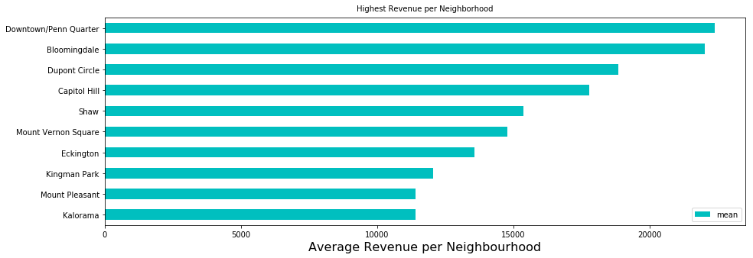
Average Revenue Per Neighborhood

Slide 5
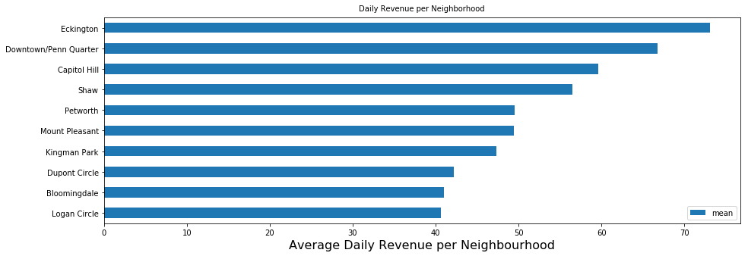
Average Daily Revenue per Neighborhood

Slide 6
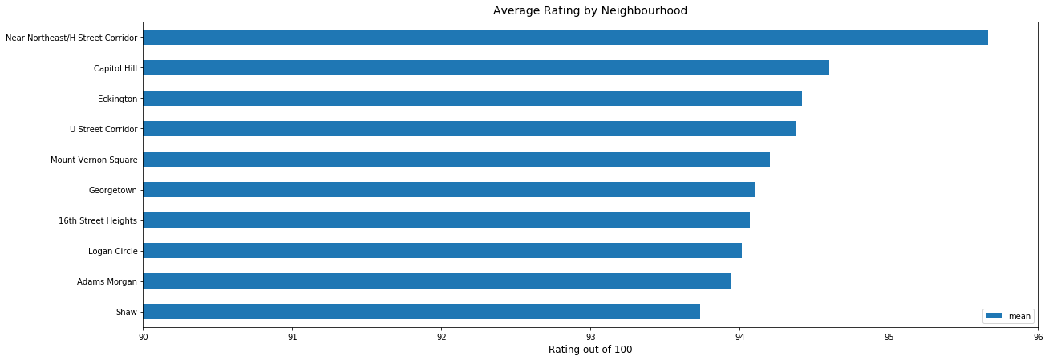
Average Rating By Neighborhood

Slide 7
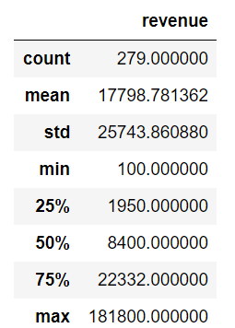
Capitol Hill Neighborhood Statistics

Slide 8
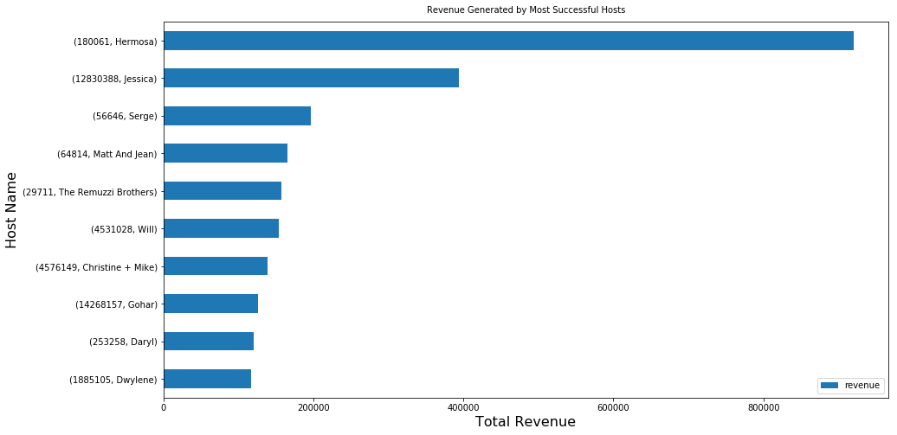
How Much Revenue Do Successful Hosts Make in DC ?

Slide 9
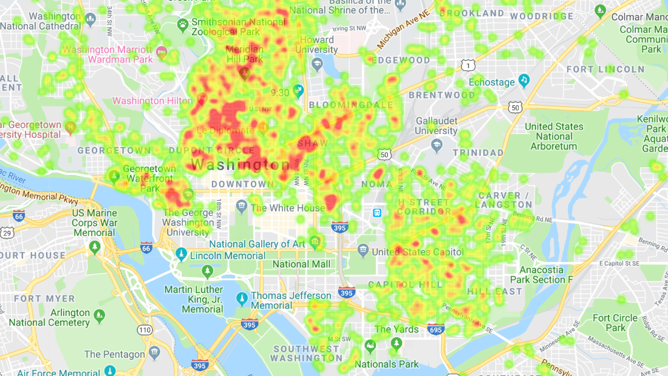
Washington DC’s AirB&B Real-estate Distribution :

Slide 10
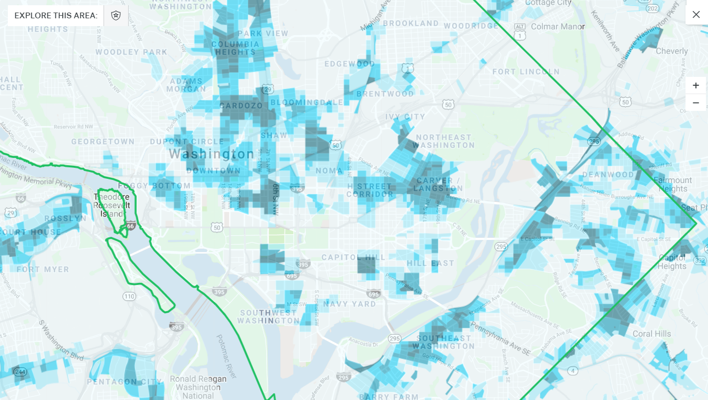

Crime Rate is Low in Capitol Hill :
Reference : https://www.trulia.com/real_estate/Washington-District_Of_Columbia/crime/

Slide 11
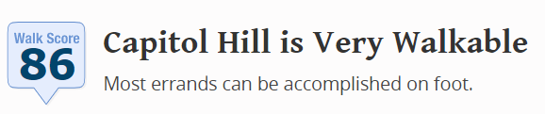
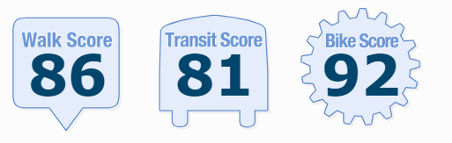
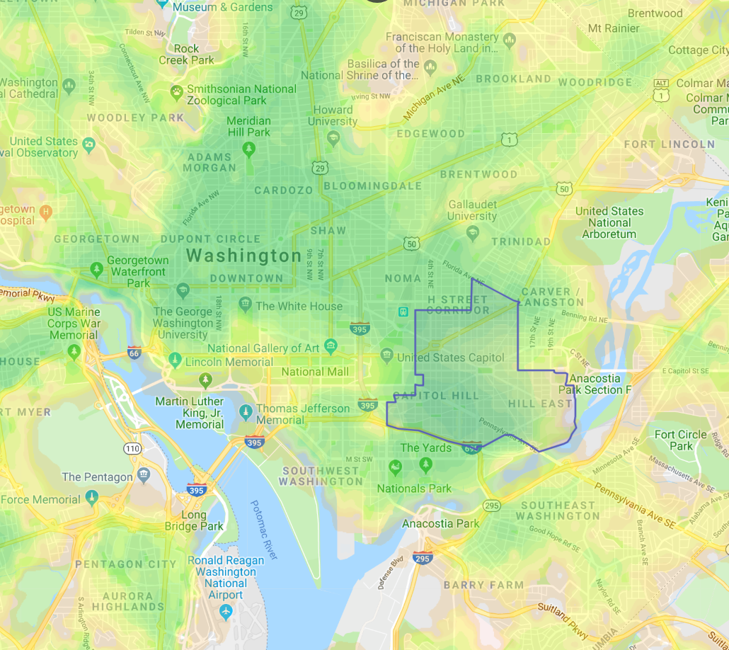
Reference : https://www.walkscore.com/DC/Washington_D.C./Capitol_Hill

Slide 12
Conclusion and Recommendation:
4th Highest Neighborhood in Average Revenue
In Close Proximity to Tourist Attractions and Universities.
Low Crime Rate.
Scores High in Terms of Walkability, Biking and Transit.
2nd Highest Neighborhood in Average Ratings.
Investing in AirB&B Real-state in Capitol Hill is a wise Decision because:

Slide 13
Data Cleaning Process:
Removed unwanted columns
Removed rows that have nulls in neighborhood
Removed rows that don’t have reviews
Converted the price type from string to float

Slide 14

We Will Be Glad To Answer Your Questions!
We Made It

